Slide 1

Engineering thesis
Platform for Effective Management of Extracurricular Activities
Autor
Bartosz Szarłowicz
Promotor
dr inż. Damian Grela
Politechnika Krakowska im. Tadeusza Kościuszki
Wydział Inżynierii Elektrycznej i Komputerowej
Katedra Automatyki i Informatyki E-1

Slide 2
Introduction
The Importance of Extracurricular Activities in Modern Education
Modern education increasingly extends beyond standard school classes.
Students engage in additional activities to meet the demands of the job market and the rising recruitment thresholds for universities.
Extracurricular activities promote individualized learning, which translates into better preparation for future educational and professional challenges.

Slide 3
Motivations
Growing Popularity of Extracurricular Activities
Lack of Comprehensive Tools on the Market
Real Need for Optimization of Extracurricular Work
4. Contact with the Target Group

Slide 4




Goal of the Engineering Thesis
Teacher
Organization of classes
Student
Parent

Slide 5

Goal of the Engineering Thesis
Teacher
Organization of classes
Student
Parent

Slide 6

Goal of the Engineering Thesis
Teacher
Organization of classes
Student
Parent

Slide 7







Technologies
MySQL
Ruby
RubyOnRails
DATABASE
BACKEND
FRONTEND
&
CACHE MEMORY
DYNAMIC UPDATE OF PAGE ELEMENTS
HANDLING ASYNCHRONOUS BACKGROUND TASKS

Slide 8

System Presentation Landing Page

Slide 9

System Presentation Login page

Slide 10

System Presentation Registration page

Slide 11
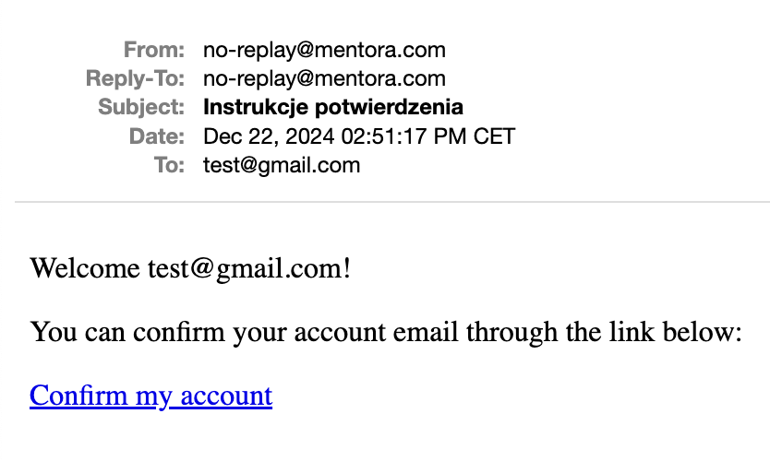
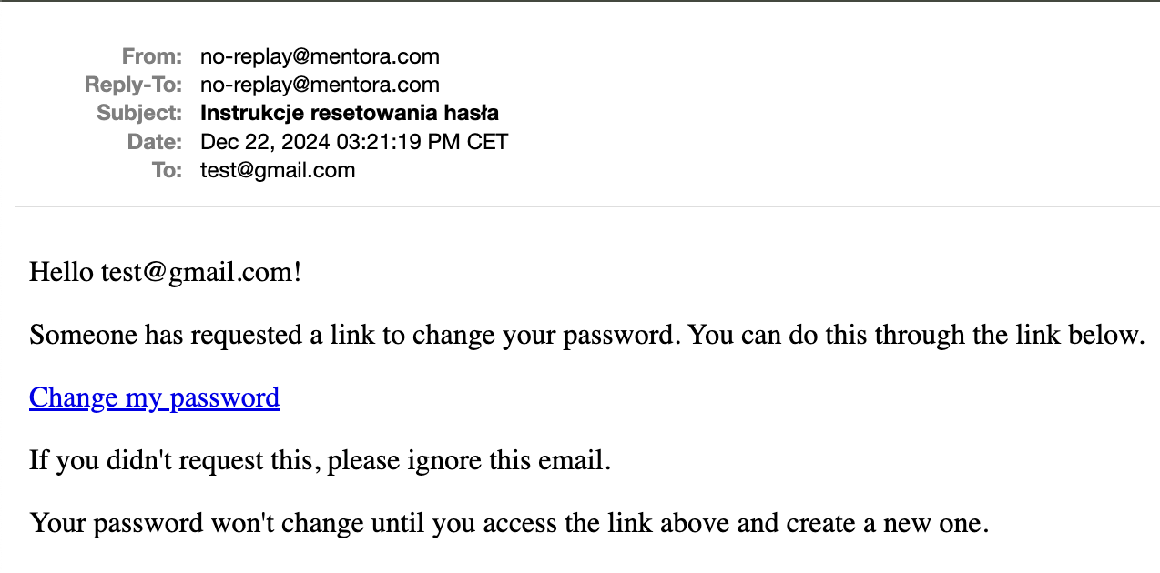
System Presentation Emails sent during registration/password recovery
Wiadomość mailowa zawierająca link aktywacyjny
Wiadomość mailowa zawierająca instrukcje dotyczące przywrócenia hasła

Slide 12
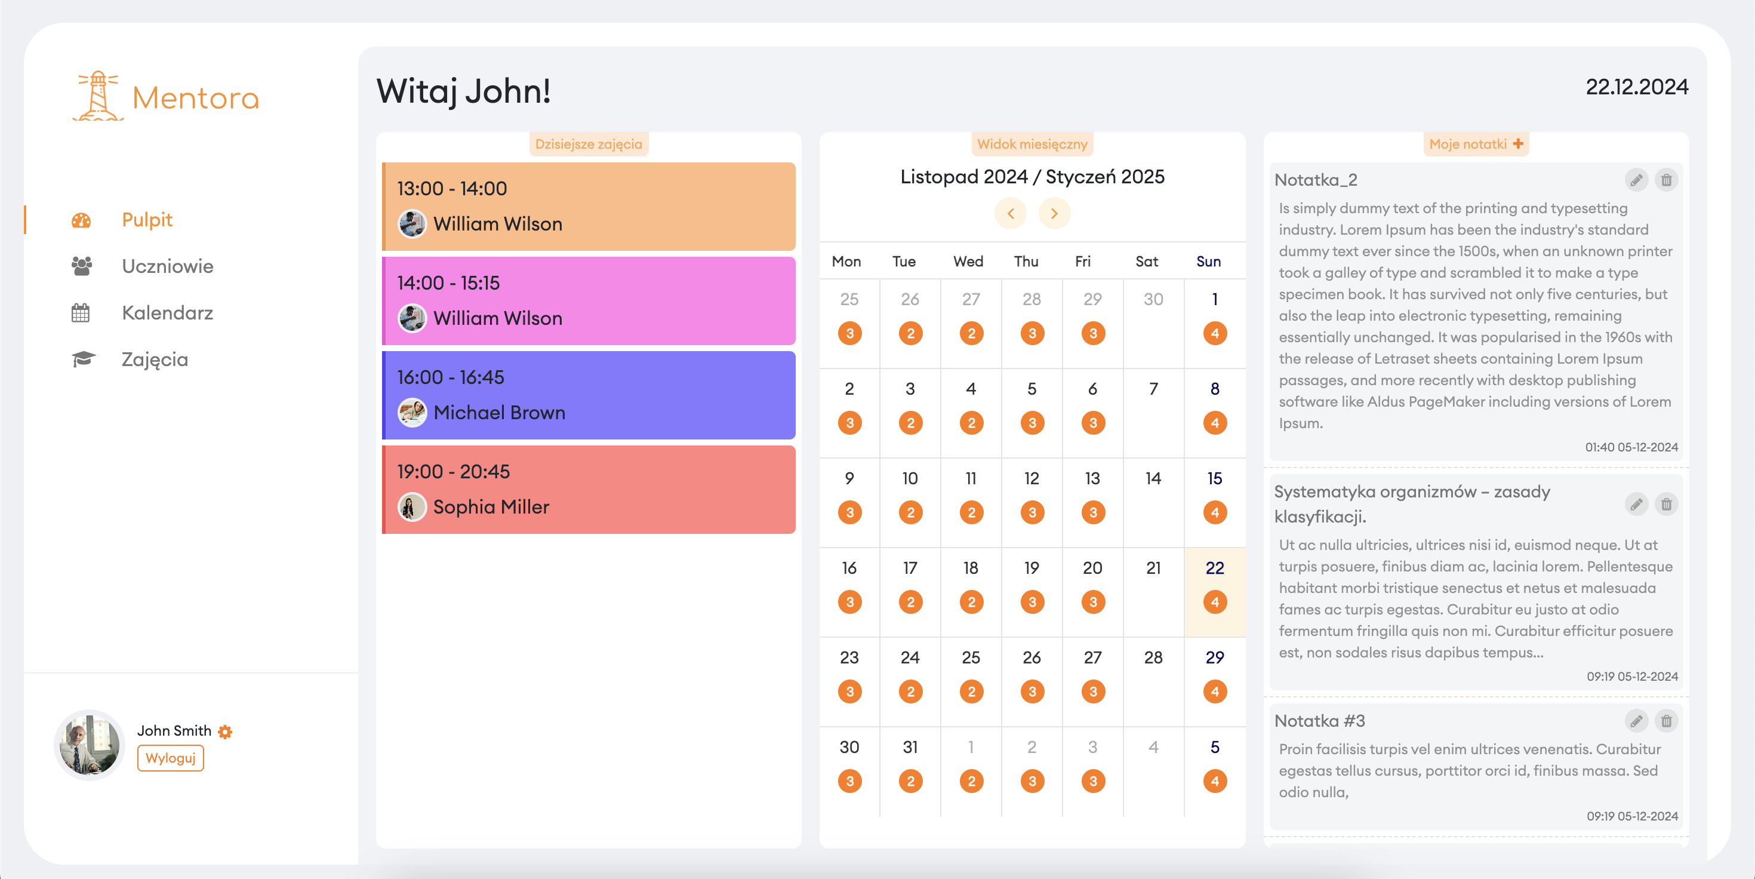
System Presentation Teacher’s account dashboard
TEACHER’S ACCOUNT

Slide 13
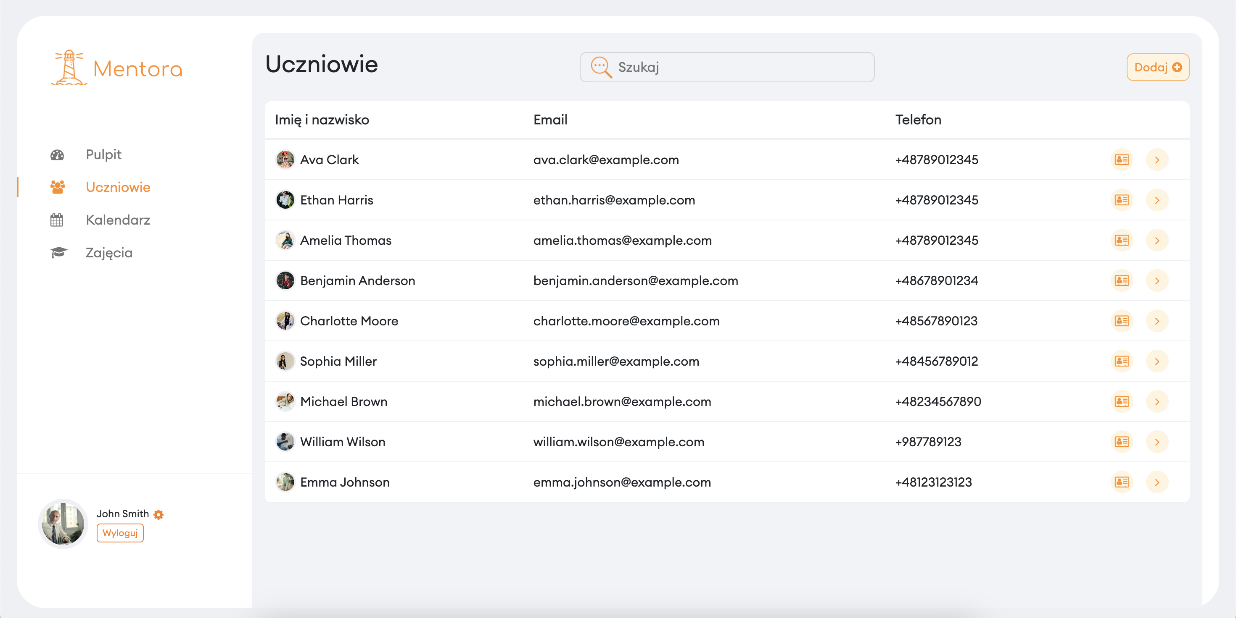
System Presentation List of students assigned to the teacher
TEACHER’S ACCOUNT

Slide 14
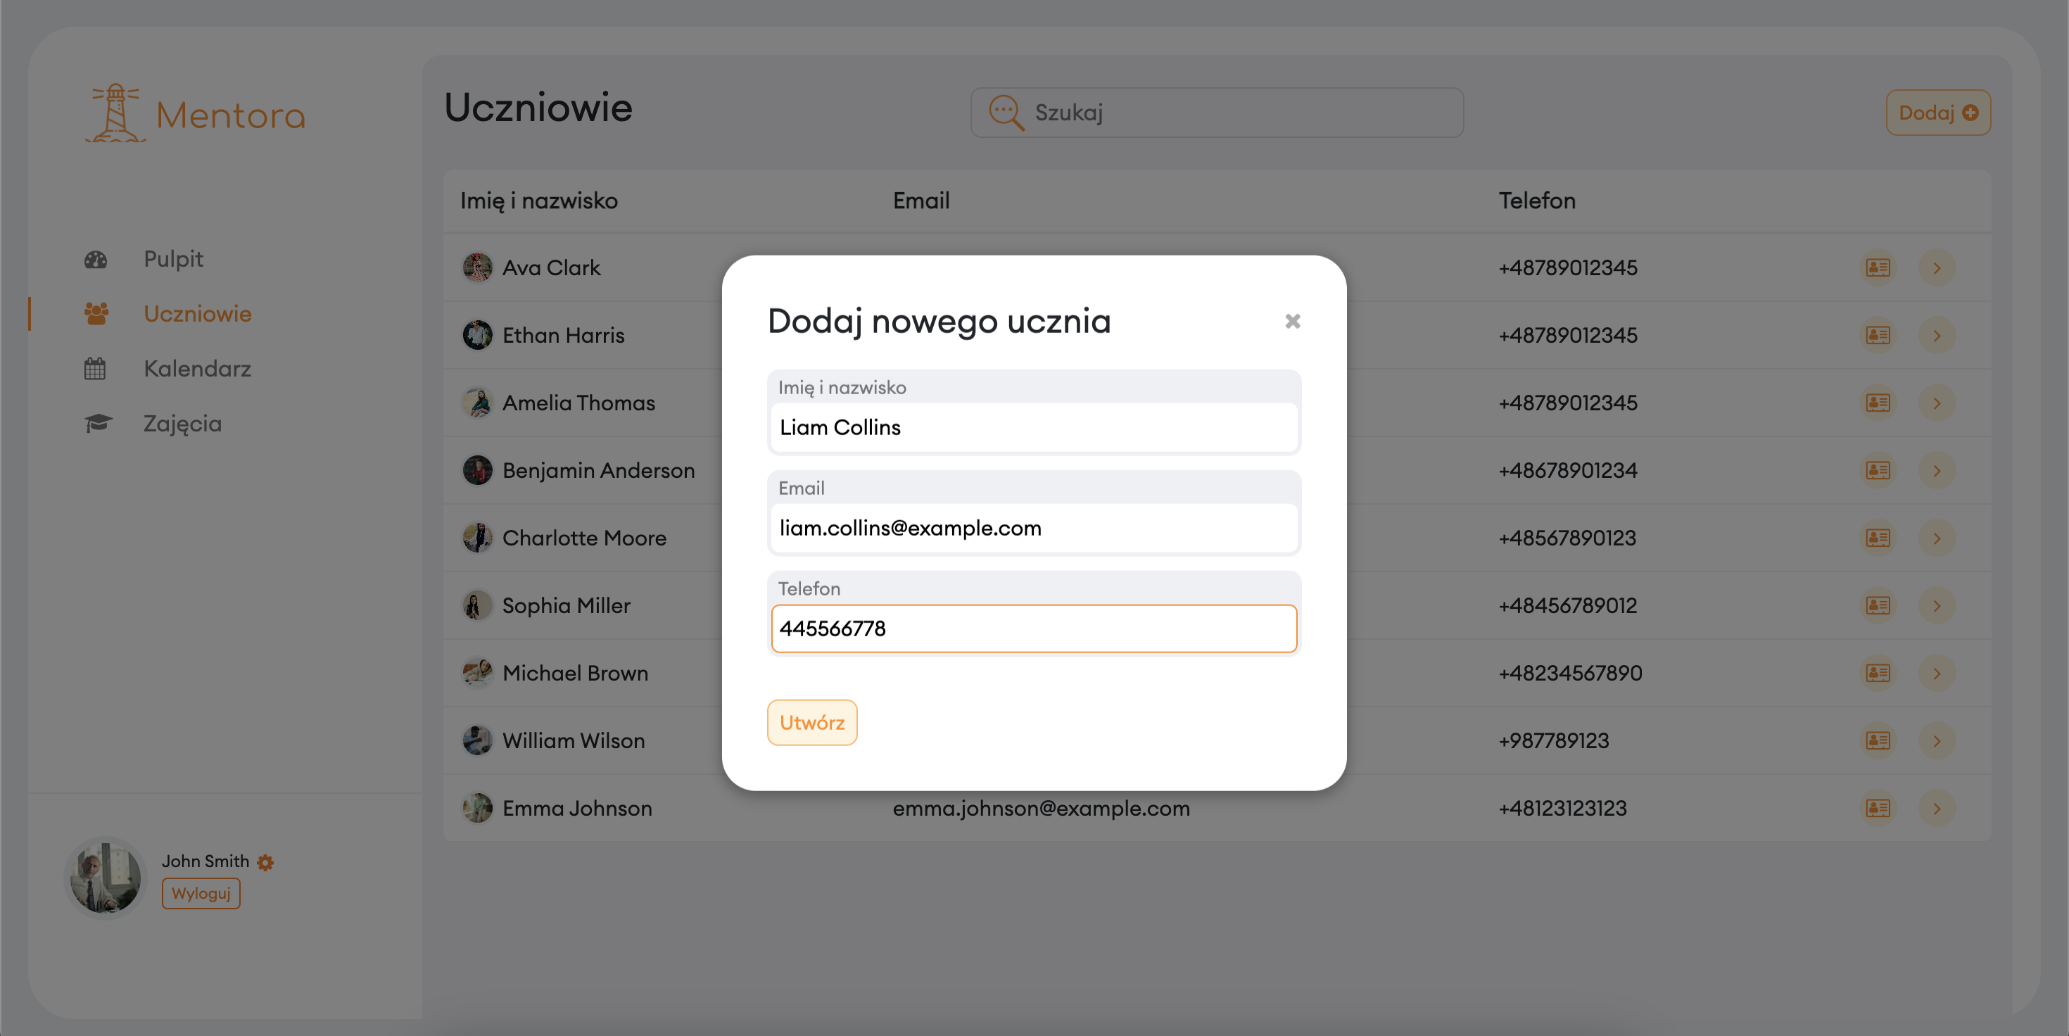
System Presentation Adding a new student
TEACHER’S ACCOUNT

Slide 15
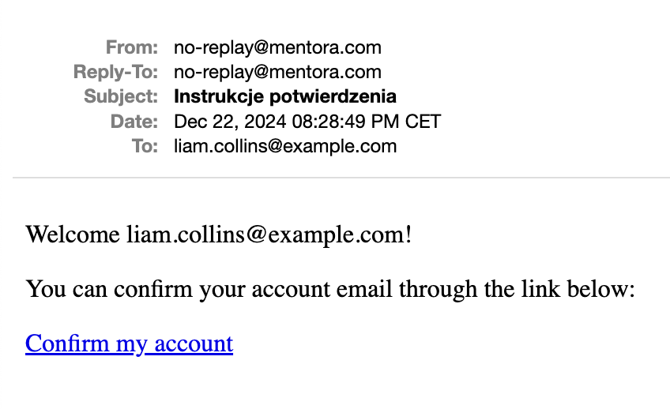
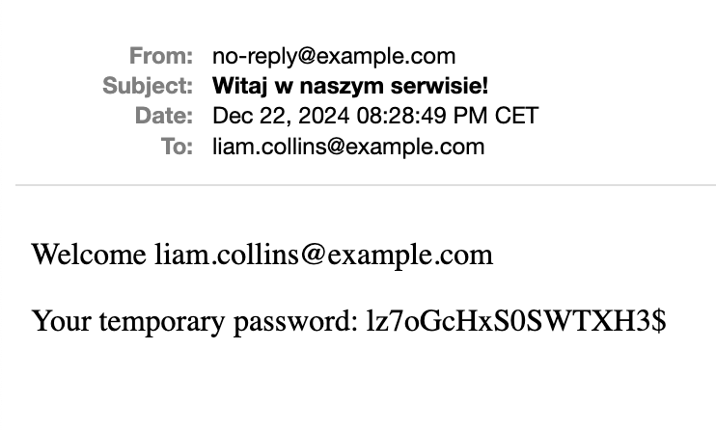
System Presentation Emails sent after adding a new student to the system
Wiadomość mailowa zawierająca link aktywacyjny
Wiadomość mailowa zawierająca tymczasowe, automatycznie wygenerowane hasło

Slide 16
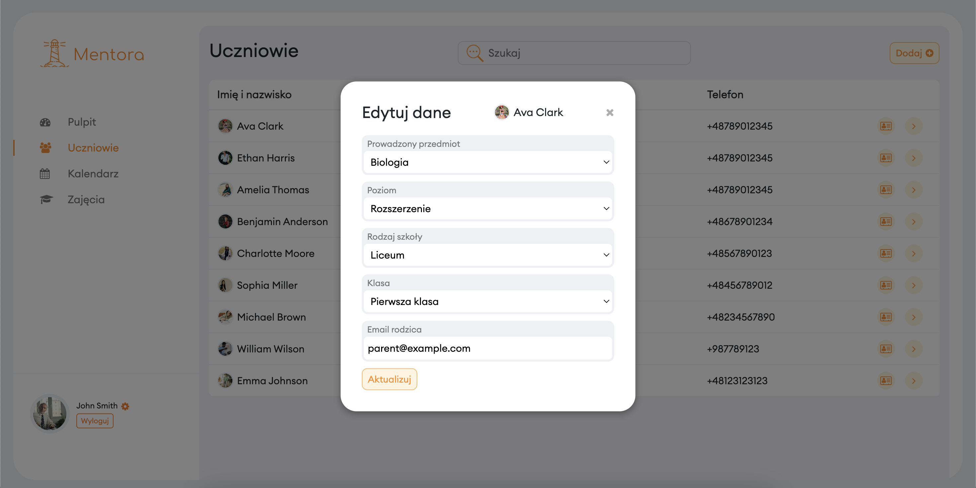
System Presentation Completing the detailed student information
TEACHER’S ACCOUNT

Slide 17
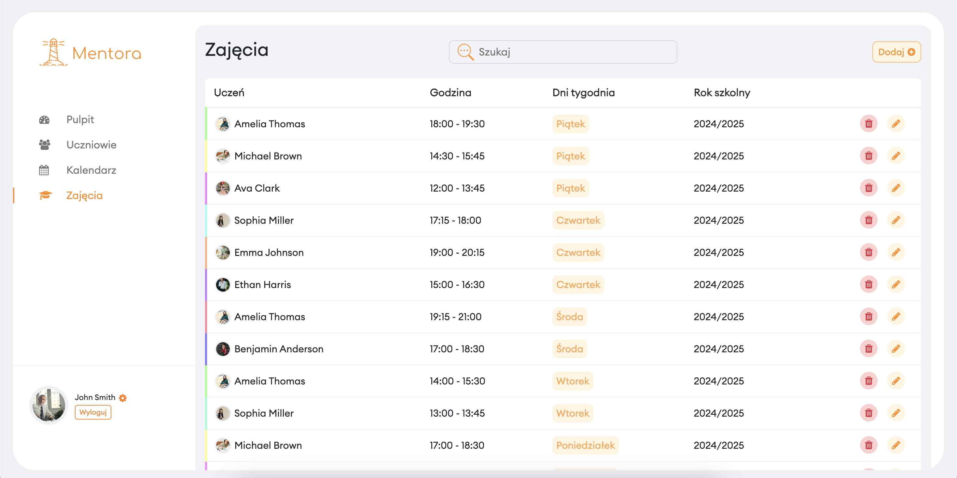
System Presentation Teacher's class schedule
TEACHER’S ACCOUNT

Slide 18
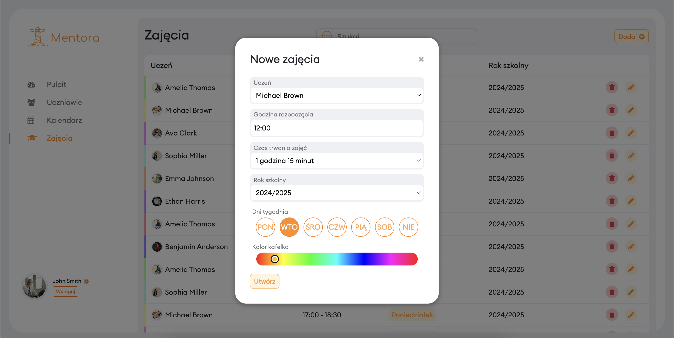
System Presentation Scheduling new classes
TEACHER’S ACCOUNT

Slide 19
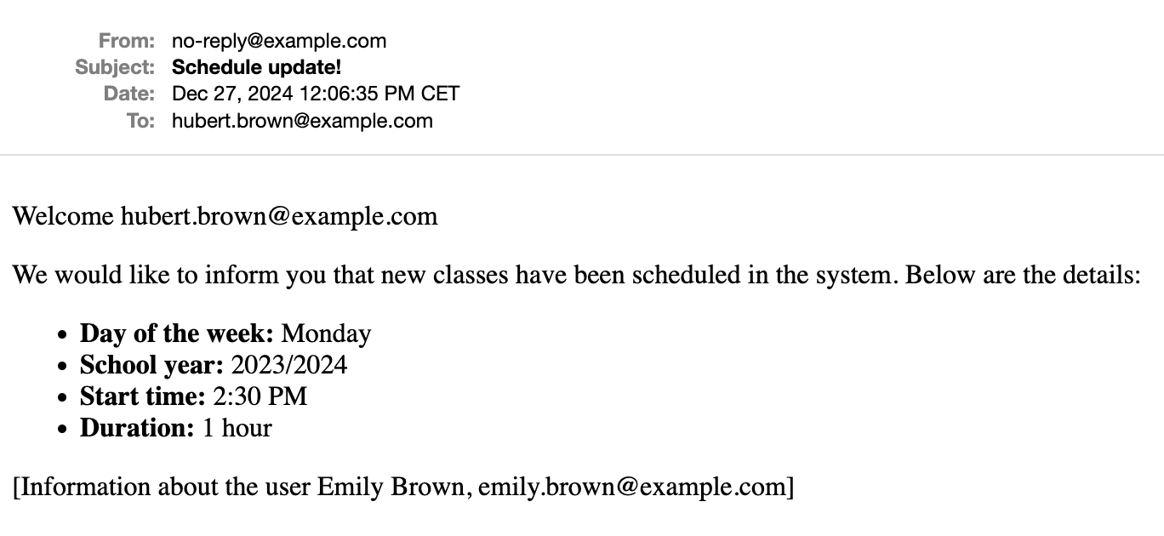
System Presentation Email sent after scheduling new classes
Wiadomość mailowa zawierająca informacje o zaplanowaniu nowych zajęć (wysyłana do ucznia oraz rodzica)

Slide 20
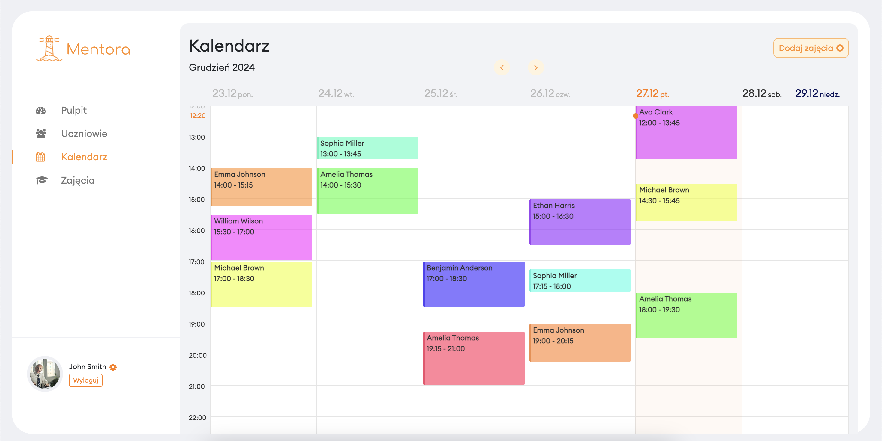
System Presentation Teacher’s calendar
TEACHER’S ACCOUNT

Slide 21
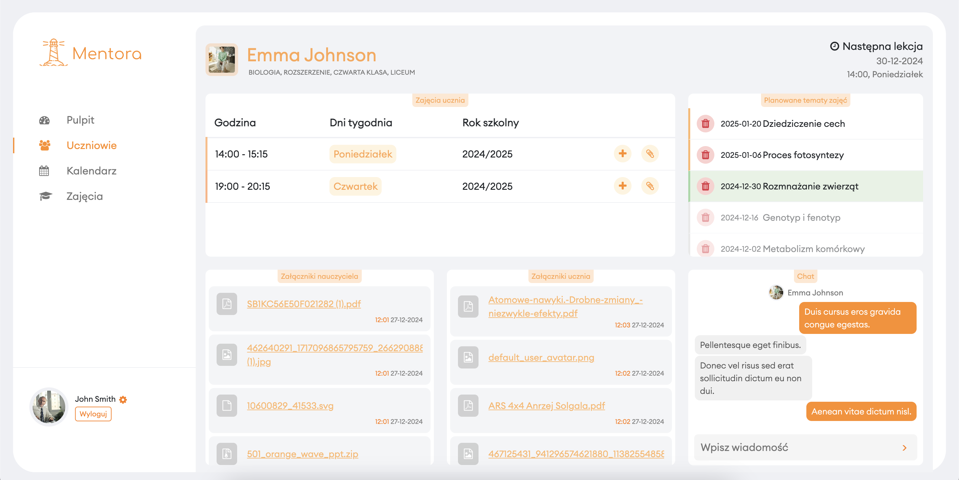
System Presentation Class panel (teacher’s perspective)
TEACHER’S ACCOUNT

Slide 22
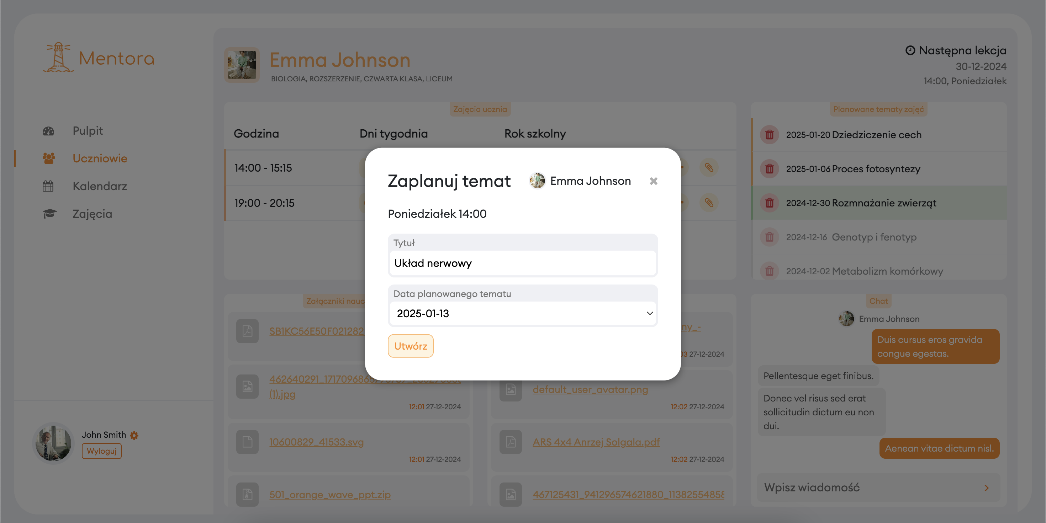
System Presentation Planning class topics
TEACHER’S ACCOUNT

Slide 23
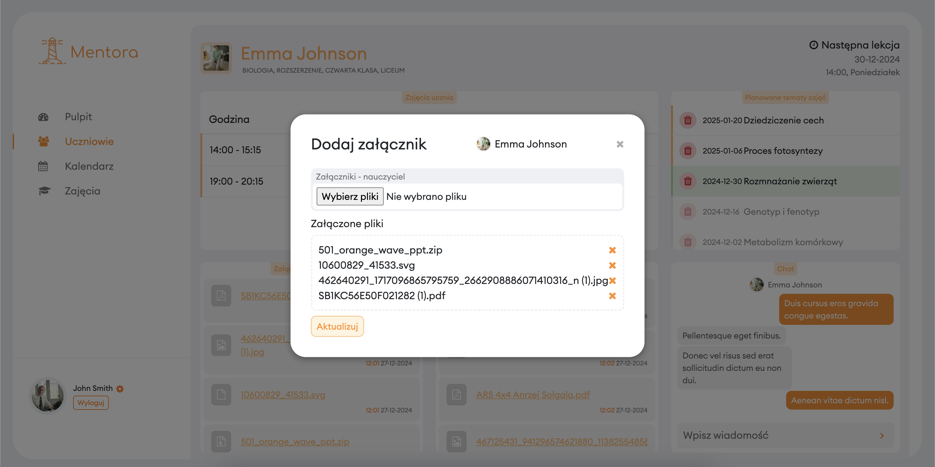
System Presentation Attaching educational materials (teacher’s perspective)
TEACHER’S ACCOUNT

Slide 24
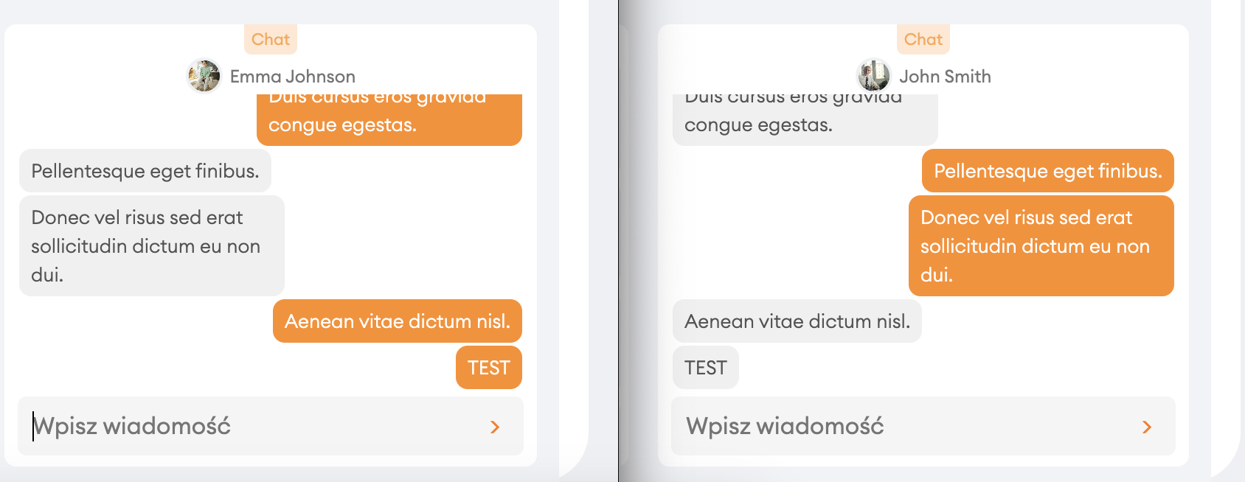
System Presentation Chat
Przeglądarka 1
Przeglądarka 2

Slide 25
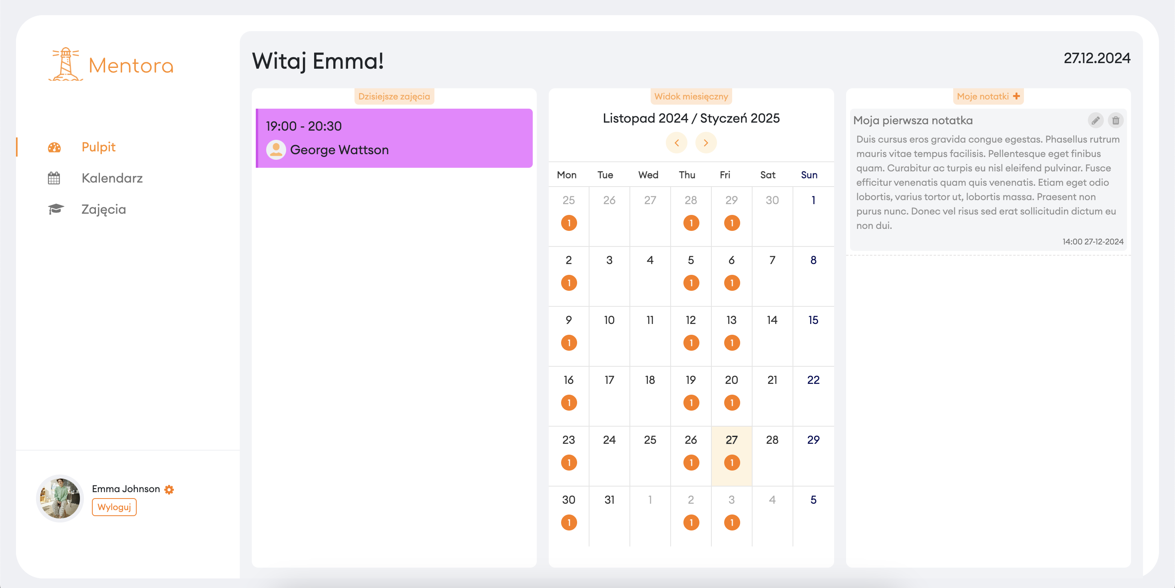
System Presentation Student’s account dashboard
STUDENT ACCOUNT

Slide 26
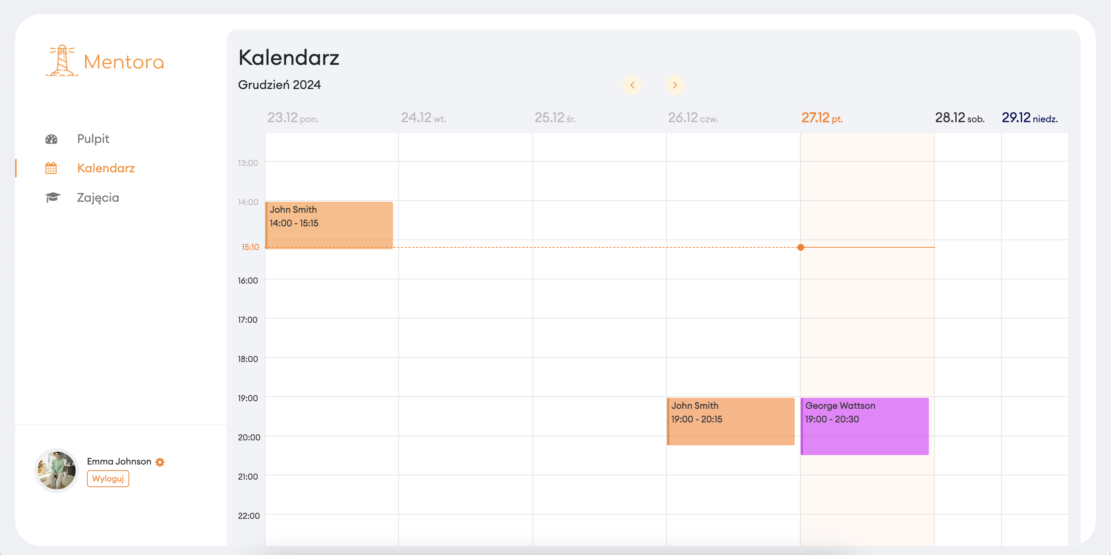
System Presentation Student's calendar
STUDENT ACCOUNT

Slide 27
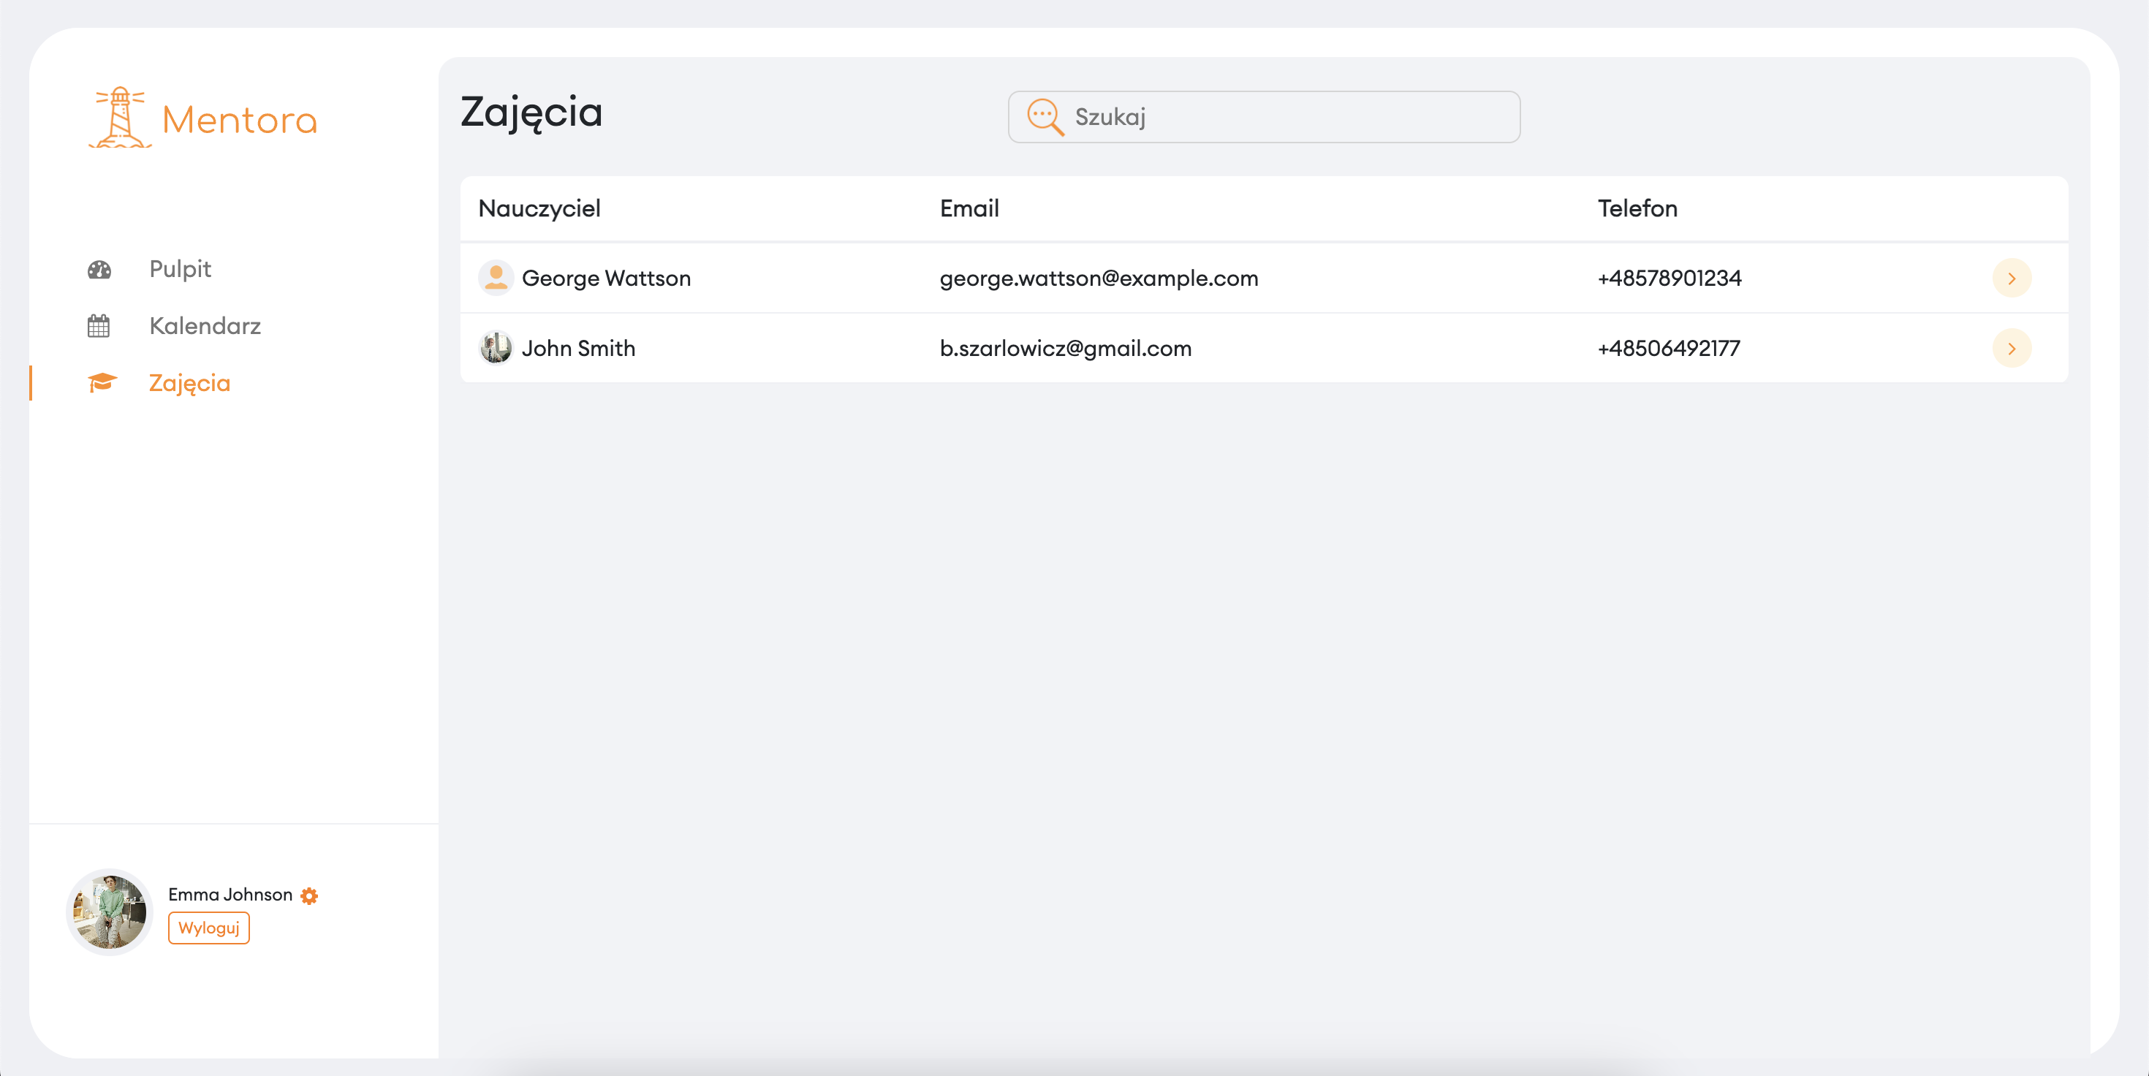
System Presentation Student's class schedule
STUDENT ACCOUNT

Slide 28
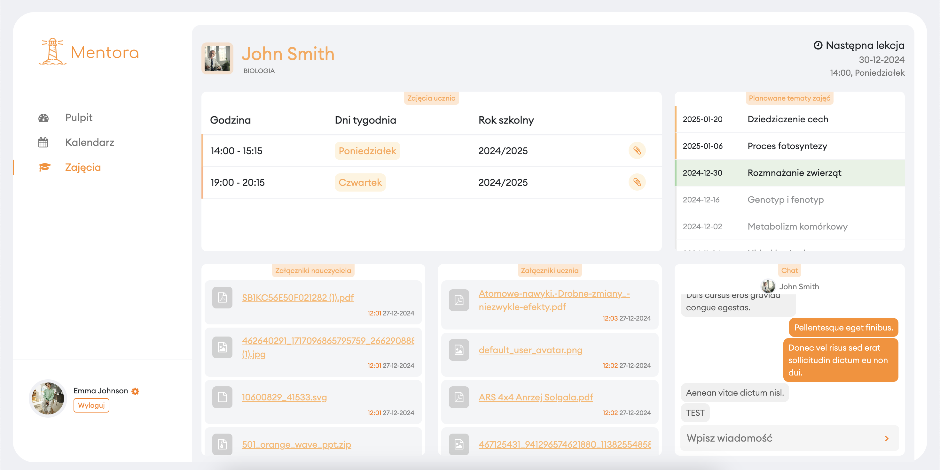
System Presentation Class panel (student’s perspective)
STUDENT ACCOUNT

Slide 29
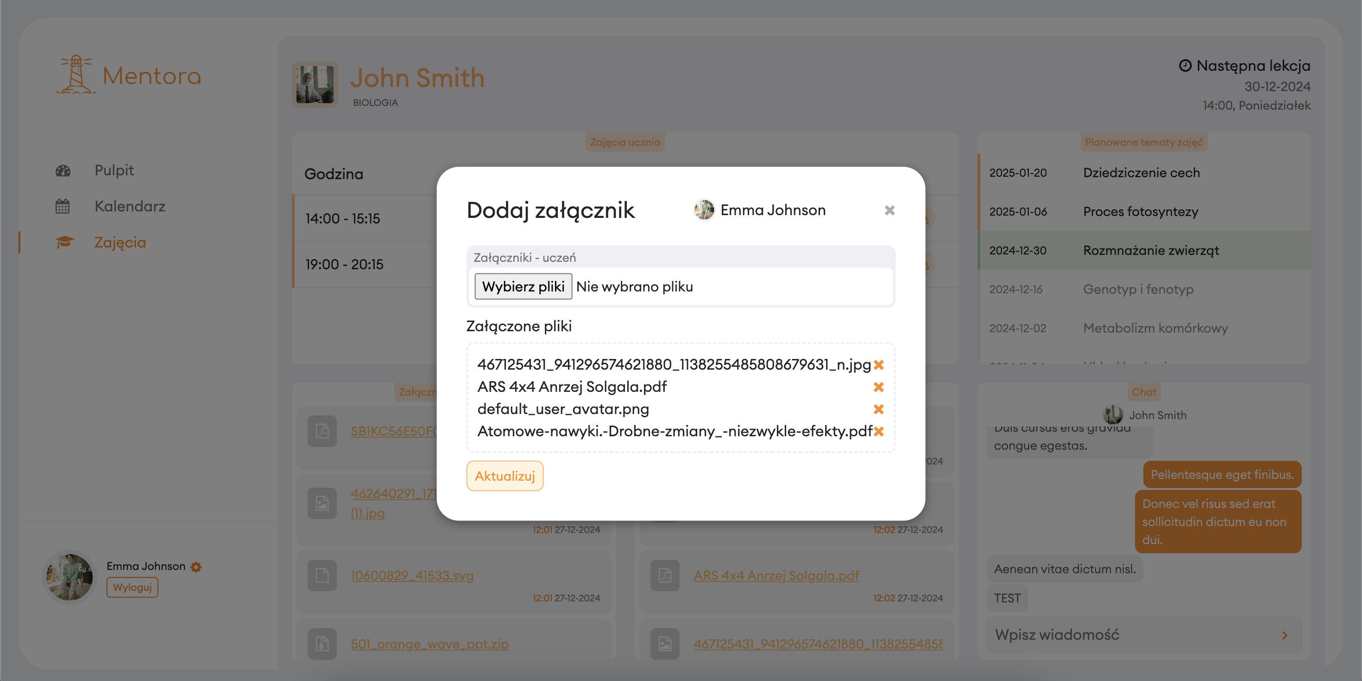
System Presentation Attaching educational materials (student’s perspective))
STUDENT ACCOUNT

Slide 30
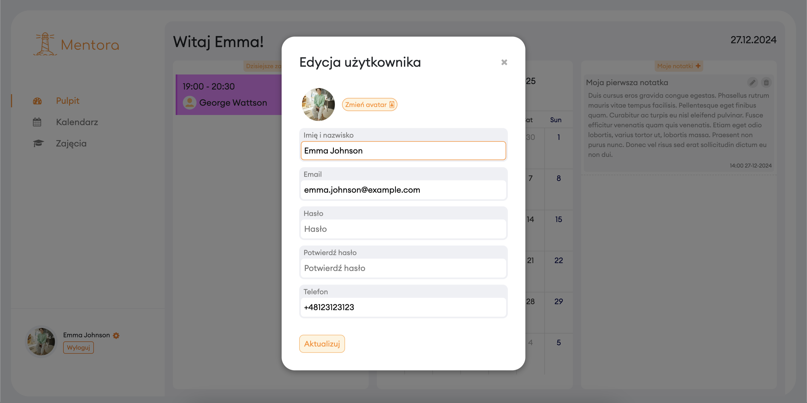
System Presentation Account data edit

Slide 31
Thank you for your attention!
Bartosz Szarłowicz

